Slide 1
CSL 554 Text and Web Intelligence Analytics
Anjali Goyal (anjaligoyal@ncuindia.edu)
Lecture 3 – 31st July 2018 (Tuesday 09:30 AM – 10:20 AM)

Slide 2
Evaluation Metrics
Relevant
Not relevant
Retrieved
Relevant Retrieved
Irrelevant Retrieved
Not Retrieved
Relevant Rejected
Irrelevant Rejected

Slide 3
How good are the retrieved docs?
Sec. 1.1
Precision : Fraction of retrieved docs that are relevant to user’s information need
Recall : Fraction of relevant docs in collection that are retrieved

Slide 4
Evaluation Metrics
Sec. 8.3
Precision: fraction of retrieved docs that are relevant = P(relevant|retrieved)
Recall: fraction of relevant docs that are retrieved = P(retrieved|relevant)
Precision P = tp/(tp + fp)
Recall R = tp/(tp + fn)
 | Relevant | Non Relevant
Retrieved | tp | fp
Not Retrieved | fn | tn

Slide 5
Question: A system returns 8 relevant documents, and 10 irrelevant documents. There are a total of 20 relevant documents in the collection. What is the precision of the system on this search, and what is its recall?
Answer
Precision = 8/18 = 0.44
Recall = 8/20 =0.4.

Slide 6
Question : For a given query there are 16 relevant documents in the collection. The precision for the query is 0.40, and the recall for the query is 0.25. How many documents are in the result set?
Answer
Precision = 0.4 = Relevant Retrieved/Result-Set
Recall = 0.25 = Relevant Retrieved/16
Relevant = 4
Result-Set = 4/0.4 = 10
10 documents in the result set

Slide 7
Explain why both precision and recall metrics are required to measure/evaluate the quality/effectiveness of an IR system than just precision or recall

Slide 8
Why not just use recall?
Sec. 8.3
You can get high recall (but low precision) by retrieving all docs for all queries! [Recall = 100%]

Slide 9
Why not just use precision?
Sec. 8.3
You can get high precision (but low recall) by retrieving zero docs for all queries! [Precision = 100%]

Slide 10
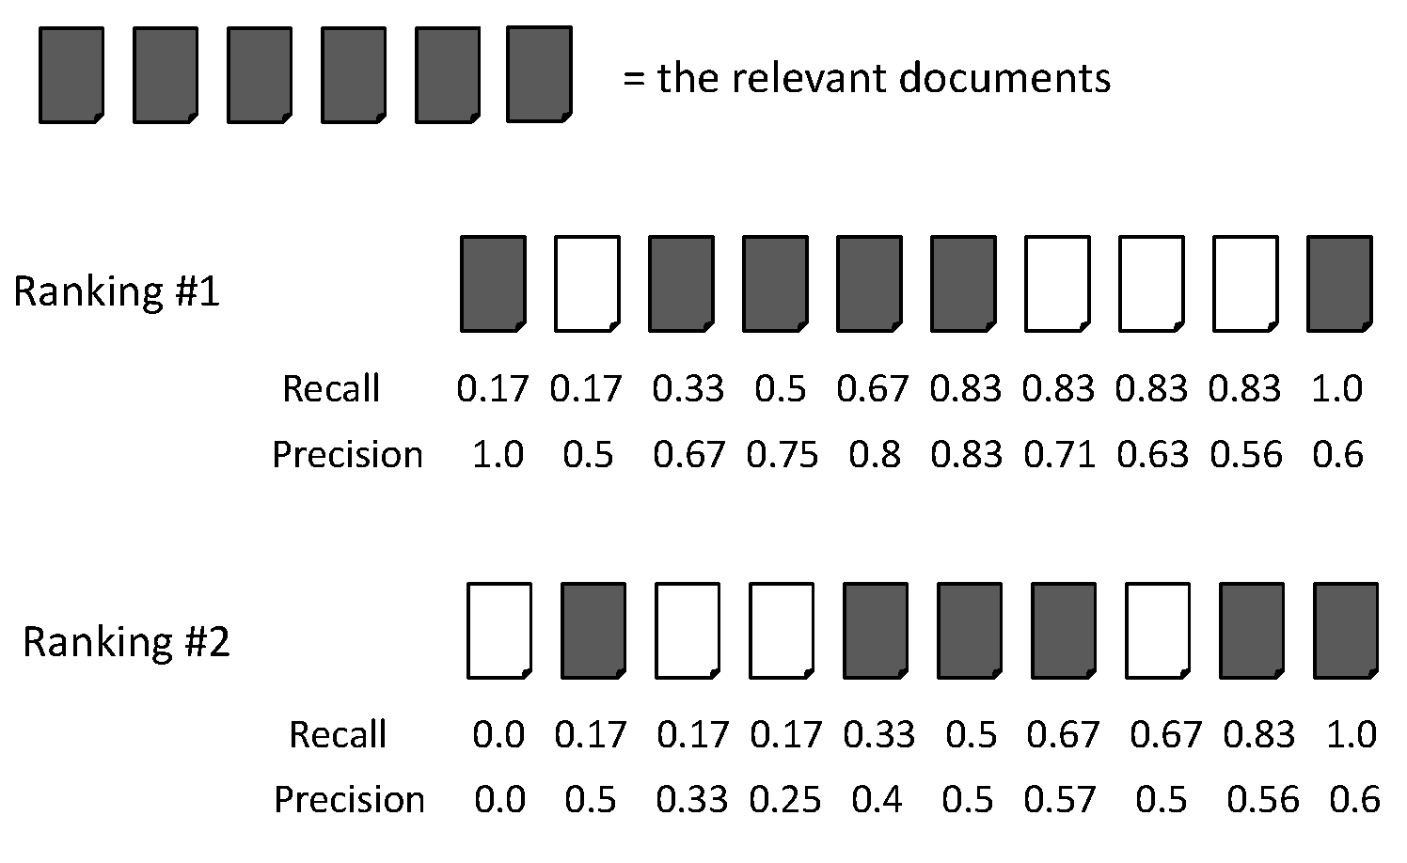
Evaluation Metrics: Example

Slide 11
Evaluation Metrics: Example
Recall = 2/6 = 0.33
Precision = 2/3 = 0.67

Slide 12
Evaluation Metrics: Example
Recall = 5/6 = 0.83
Precision = 5/6 = 0.83

Slide 13
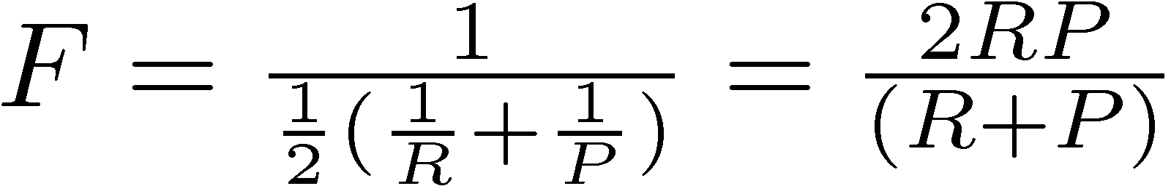
F Measure
Harmonic mean of recall and precision

Slide 14
Evaluation Metrics: Example
Recall = 2/6 = 0.33
Precision = 2/3 = 0.67
F = 2*Recall*Precision/(Recall + Precision)
= 2*0.33*0.67/(0.33 + 0.67) = 0.22

Slide 15
Evaluation Metrics: Example
Recall = 5/6 = 0.83
Precision = 5/6 = 0.83
F = 2*Recall*Precision/(Recall + Precision)
= 2*0.83*0.83/(0.83 + 0.83) = 0.83

Slide 16
Bigger collections
Sec. 1.1
Consider N = 1 million documents, each with about 1000 words.
Avg 6 bytes/word including spaces/punctuation
6GB of data in the documents.
Say there are M = 500K distinct terms among these.

Slide 17
Can’t build the matrix
Sec. 1.1
500K x 1M matrix has half-a-trillion 0’s and 1’s.
But it has no more than one billion 1’s.
matrix is extremely sparse.
What’s a better representation?
We only record the 1 positions.

Slide 18
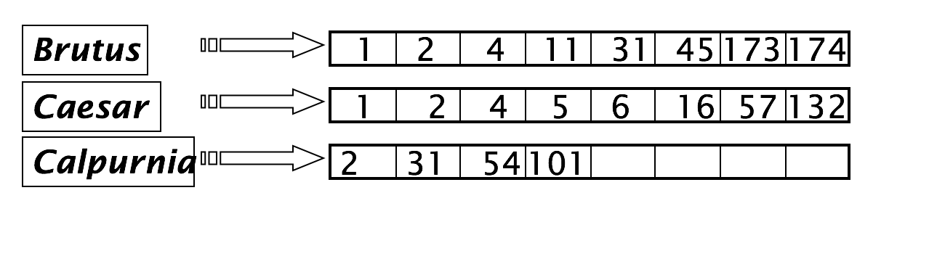
Inverted index
Sec. 1.2
For each term t, we must store a list of all documents that contain t.
Identify each by a docID, a document serial number
Can we used fixed-size arrays for this?

Slide 19
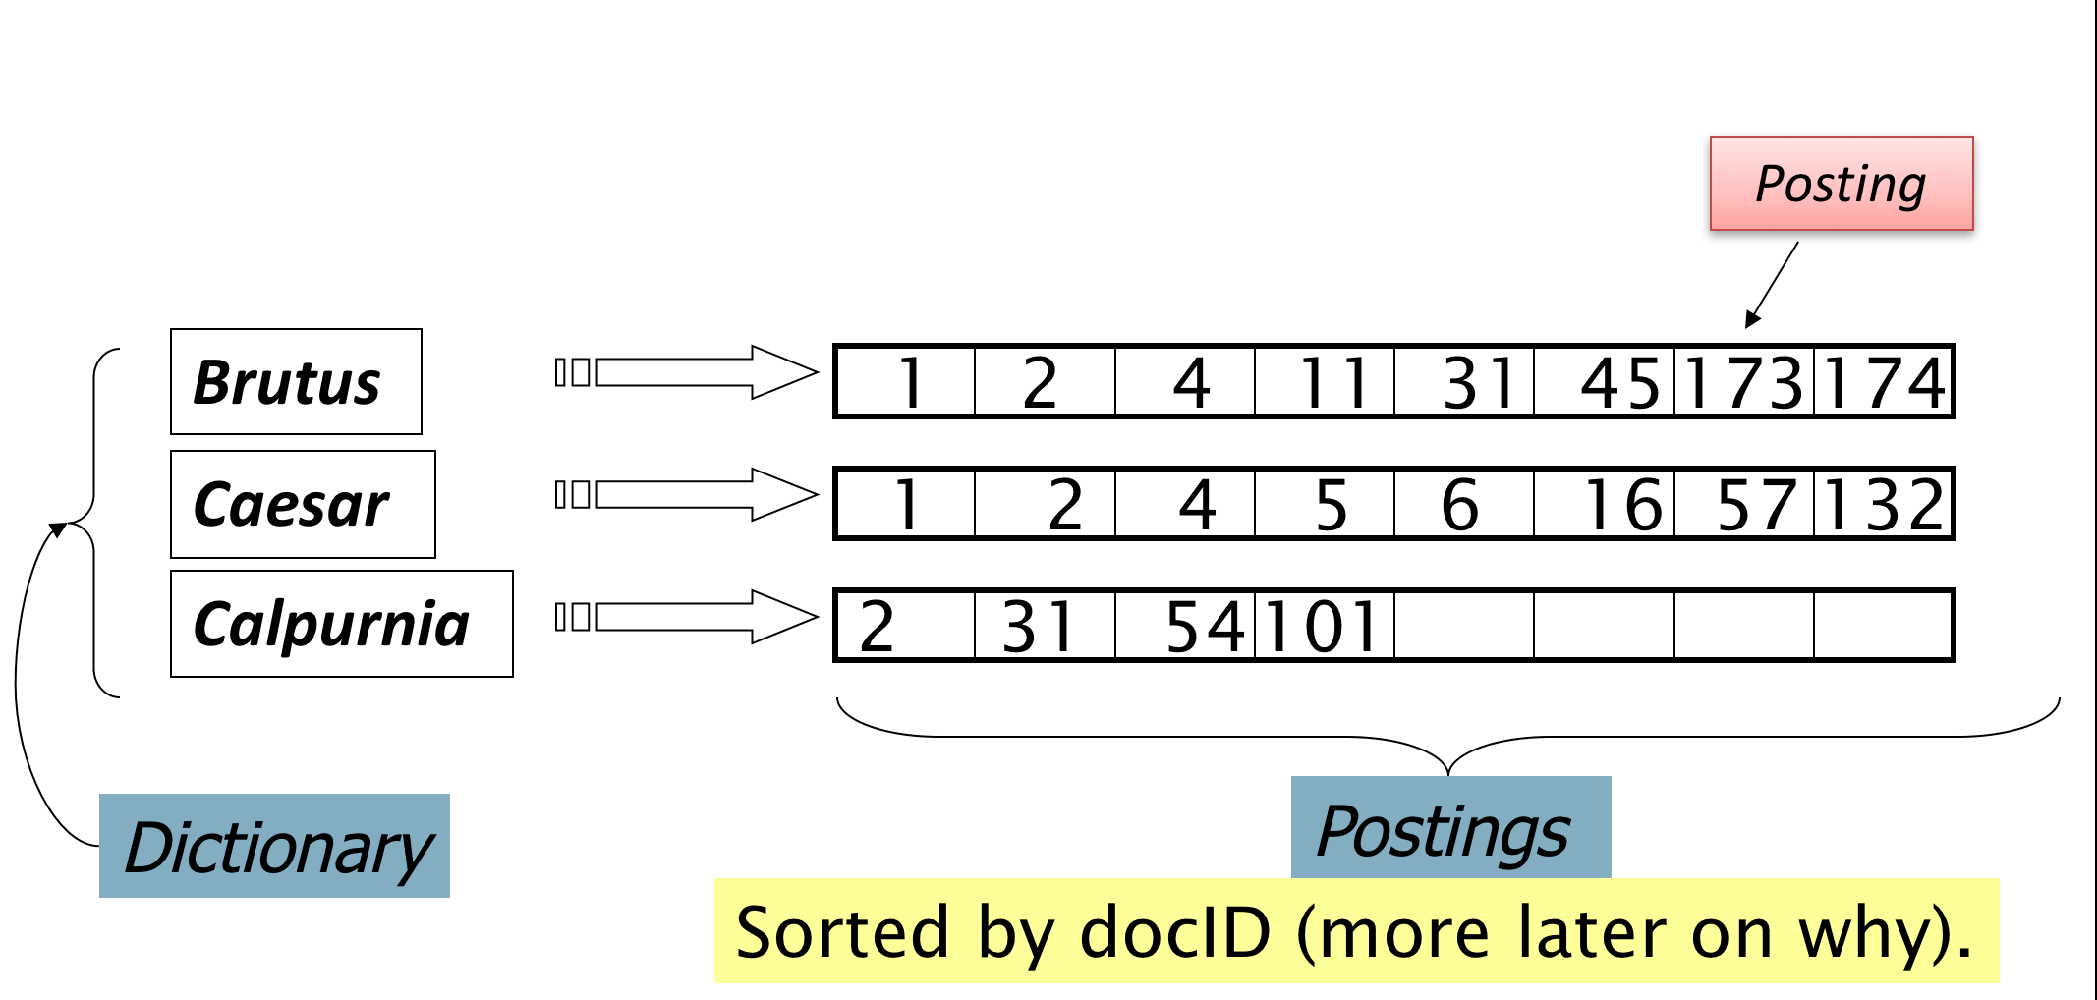
Inverted index
Sec. 1.2
We need variable-size postings lists
Notes:
Linked lists generally preferred to arrays
Dynamic space allocation
Insertion of terms into documents easy
Space overhead of pointers

Slide 20





Inverted index construction
Sec. 1.2
Documents to
be indexed.
Friends, Romans, countrymen.
Tokenizer
Token stream.
Friends
Romans
Countrymen
More on
these later.
Linguistic modules
Modified tokens.
friend
roman
countryman
Indexer
friend
2
4
roman
1
2
Inverted index.
countryman
13
16

Slide 21

Thank You

